Slide 1
DGMEFN Strategic Commissioning Plan Presentation
12/05/22

Slide 3
Aim
Present the IJB model of health and social care and support
to illustrate how the model represents health and social care and support provision across all sectors
To show how DGMEFN supports delivery of the model

Slide 4
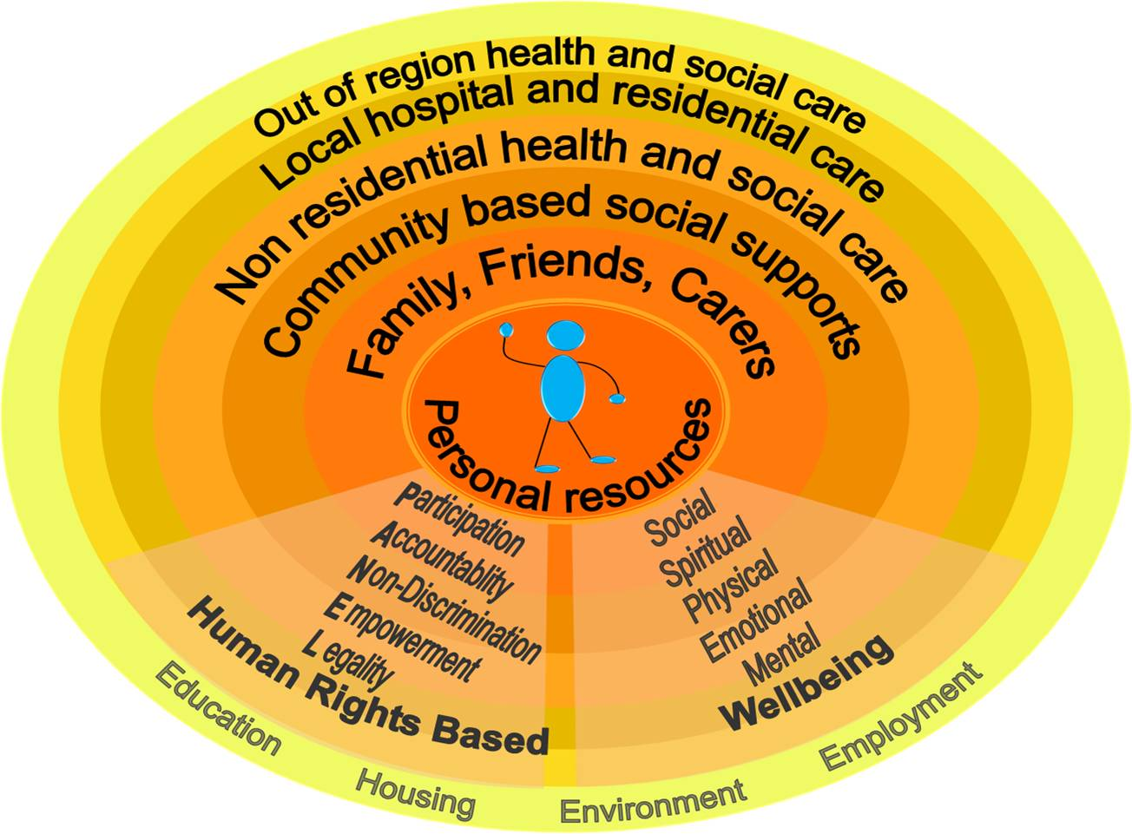
The model of health and social care and support

Slide 5
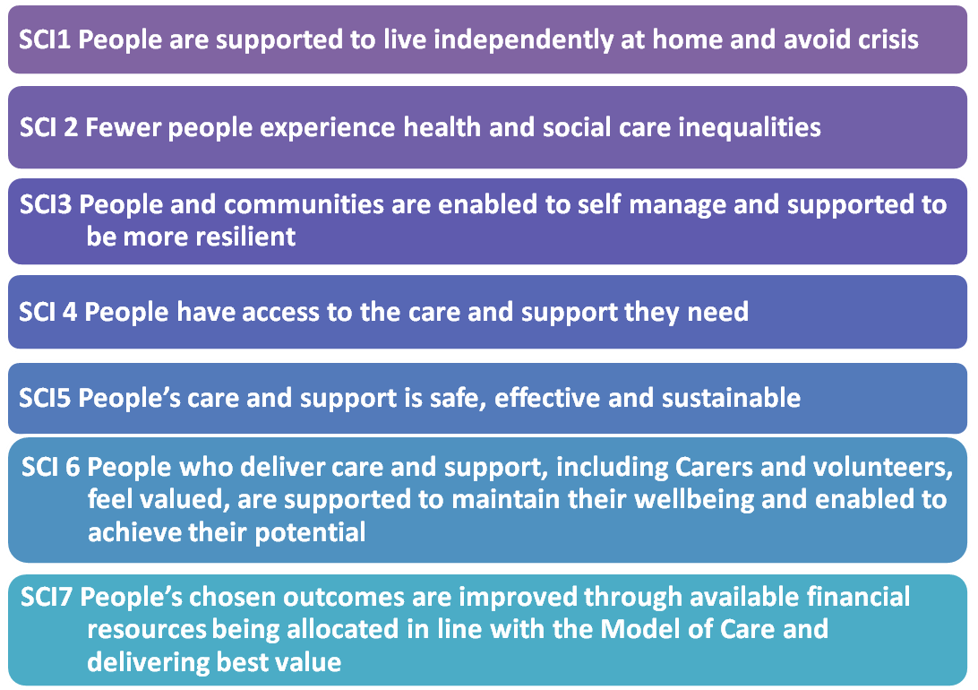
SCP Strategic Commissioning Intentions

Slide 6
Delivery Plan
The Delivery Plan consists of 6 key components with sub sections/headings
Delivery Overview
Accountability
Impact Assessment
Outcomes
Delivery against aim
Finance

Slide 7
Any questions or comments?

